Slide 1
Hands-on Tutorial for Deep Learning
Qitian Wu Department of Computer Science and Engineering
Shanghai Jiao Tong University

Slide 2
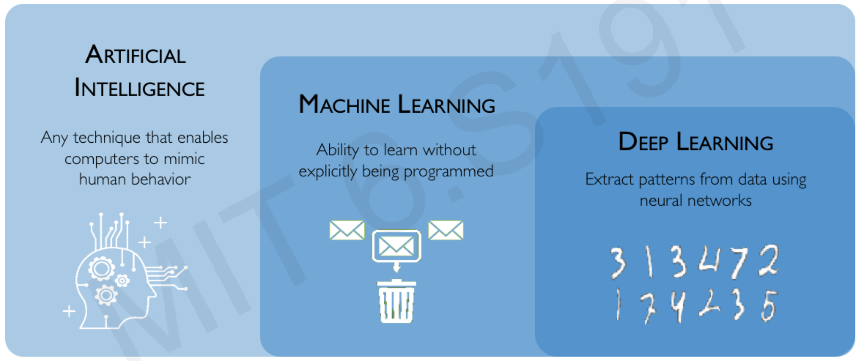
What is deep learning
from http://introtodeeplearning.com/slides/

Slide 3
Lecture Summary
The foundation of neural networks
1 hour
Tutorial on Pytorch using Colab platform
20 min
Variants of neural networks: CNN, RNN, GNN, Transformer
40min
Case study: digit recognition, image classification, time sequence prediction, graph node classification
40 min
*Application: logical visual question answering, meta user preference learning, neural relation inference
20min

Slide 4
The Differences of This Tutorial
A proper balance between theory and practice
A focus on fundamental methods and implementations
Hands-on mathematical derivation and experimental coding
Prerequisites: calculus, linear algebra, probablistic theory, basic programming skill (Python, C++ or Matlab)

Slide 5
Foundation of neural networks

Slide 6
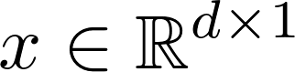
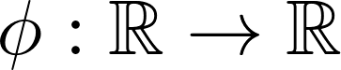
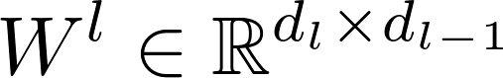
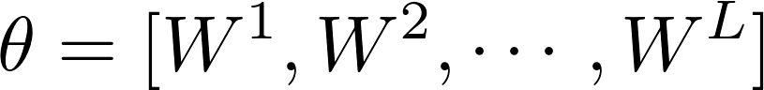
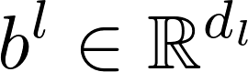
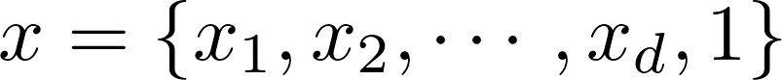
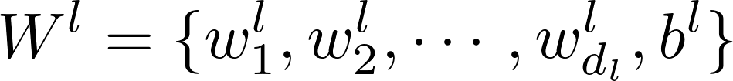
Model Formulation
A neural network is defined as a sequence of weight matrix multiplication and non-linear activations
where is input vector (image, text, user feature, etc.)
is non-linear activation function
is weight matrix in the l-th layer
denotes model parameters
Note: 1) we skip bias vector by using notation
2) also called as fully-connected network

Slide 7
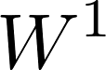
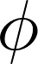
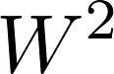
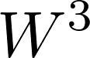
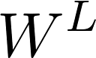
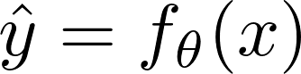
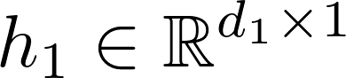
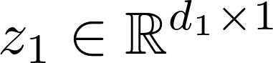
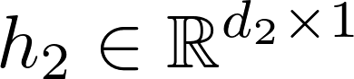
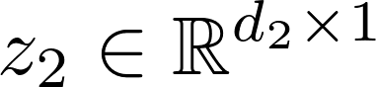
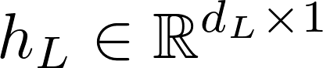
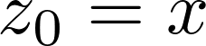
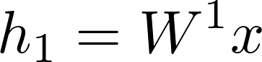
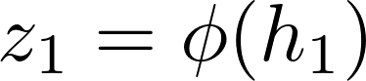
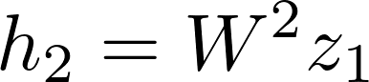
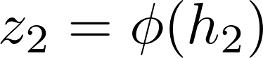
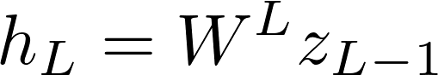
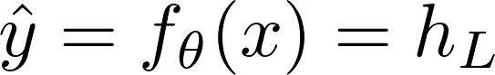
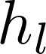
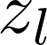
Model Formulation
z
z
z
…
z
Recursive definition:
…
: pre-activation
: (post-)activation

Slide 8
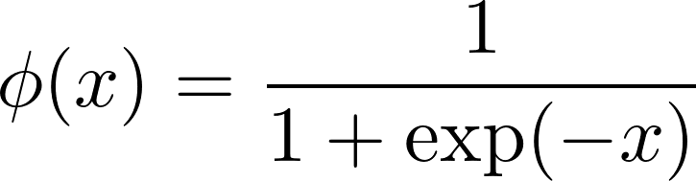
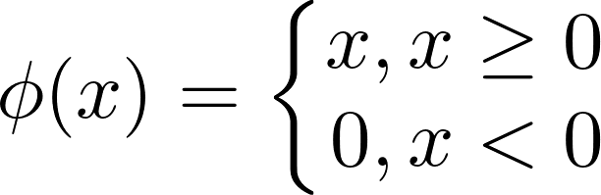
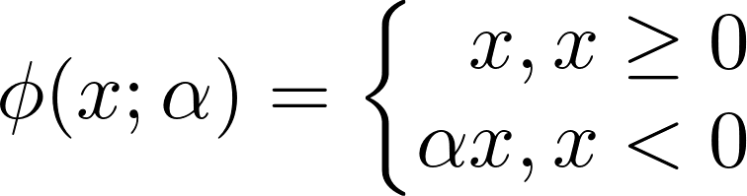
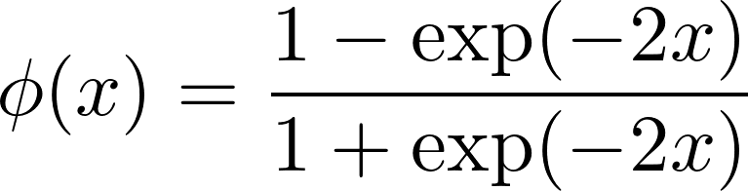
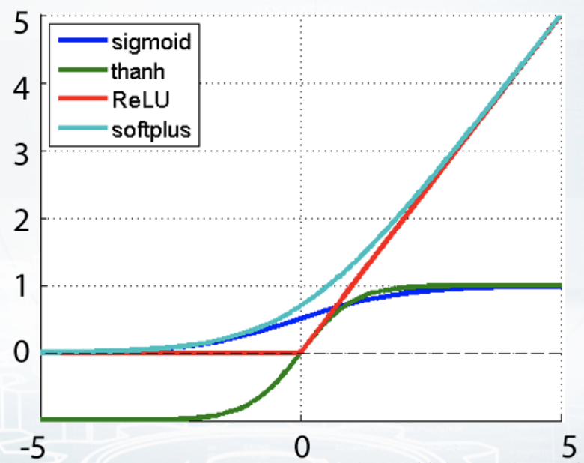
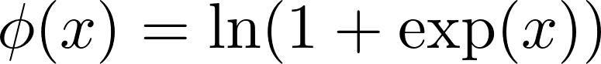
Activation Function
- Sigmoid
- Relu & Leaky Relu
- Tanh
- Softplus

Slide 9
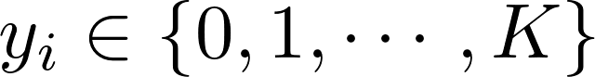
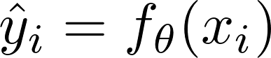
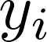
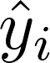
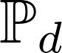
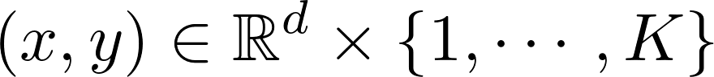
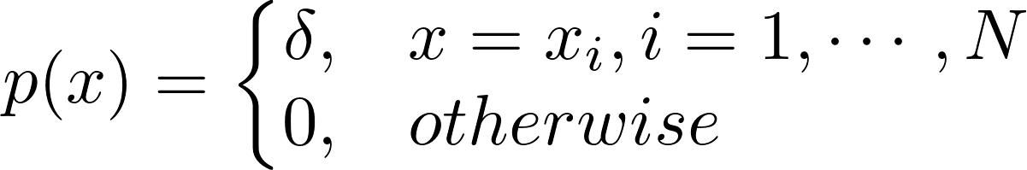
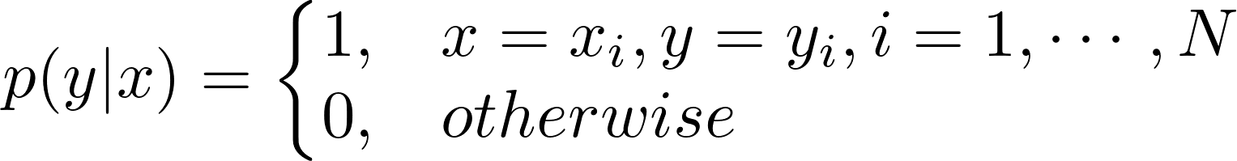
Supervised Learning: Classification
Given training dataset
Here is a categorical variable with K classes
Goal: make model prediction close to the label
How to measure the difference between and ?
- Assume data distribution with support
and density

Slide 10
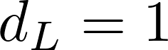
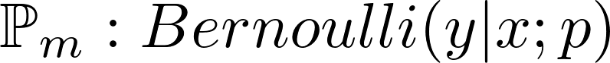

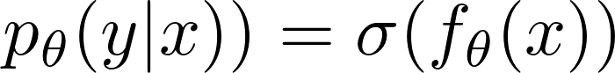
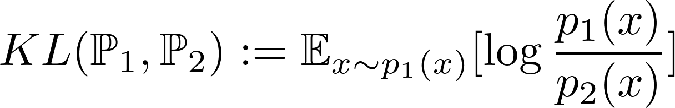
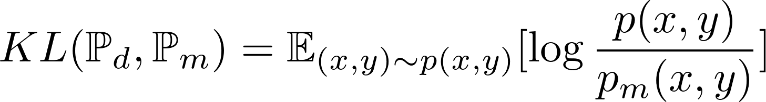
Supervised Learning: Classification (cont.)
How to measure the difference between and ?
- For binary classification (K=2), we use our neural network with to model a Bernoulli distribution
where
- To measure differences between two distributions with the same support, we consider Kullback-Leibler (KL) divergence:
Thus we have

Slide 11
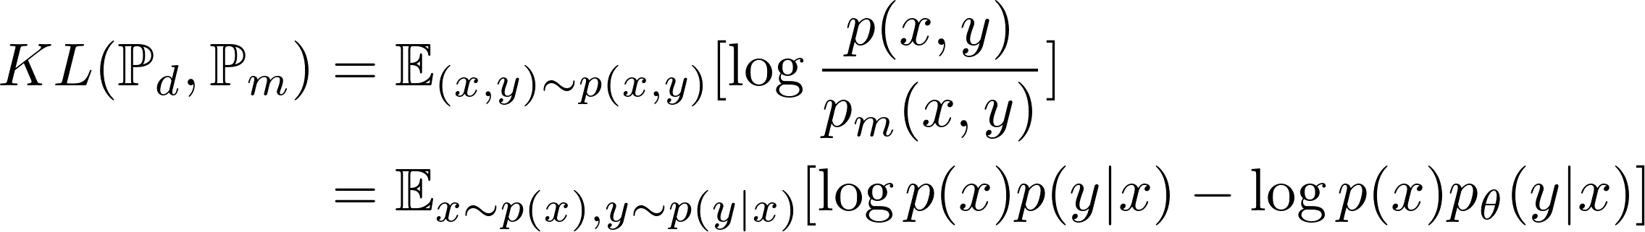
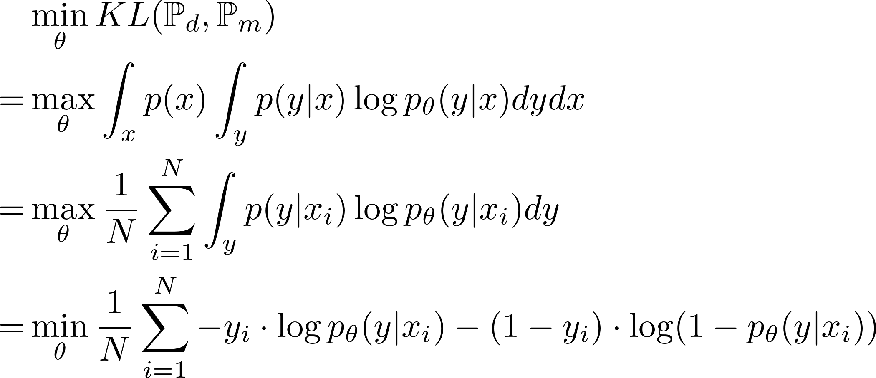
Supervised Learning: Classification (cont.)
How to measure the difference between and ?
Note that our goal is to optimize model parameter, so we only need to take care of the second term in the objective
cross-entropy or
negative log-likelihood

Slide 12
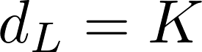



Supervised Learning: Classification (cont.)
How to measure the difference between and ?
- For multi-class classification (K>2), we use our neural network with to model a Multinomial distribution
- Similar, the loss function can be given by KL divergence and equivalently we have

Slide 13





Supervised Learning: Regression
Given training dataset
Here is a continuous variable
Goal: make model prediction close to the label
- Assume data distribution with support and density
- We use our neural network with to model a Gaussian distribution where

Slide 14


Supervised Learning: Regression (Cont.)
- We further use KL divergence to measure the difference between model prediction and ground-truth label
square loss or L2 loss

Slide 15







Stochastic Gradient Descent (SGD)
How to solve the optimization for model parameter ?
- One straightforward way is to compute first-order gradient for each parameter and solve T equations (T is number of parameter).
Intractable!
- We divide the training process into multiple steps and update the parameter with a small step size using gradient at current point
Initialization and
While and
end

Slide 16













Back-Propagation Gradient Computation
- Computation graph: a representation for tensor computation; each node denotes a variable and each edge denotes one computation operation
…
How to compute gradients for coder?
- Chain rule
- Sum rule

Slide 17




Back-Propagation Gradient Computation
…
Note that we only need gradients for weight matrices
Lemma
where

Slide 18






Back-Propagation Gradient Computation
Dynamic Programming
- We can save previous results with some extra space and compute gradients from end to beginning in an iterative way
Initialization
For

Slide 19
















Back-Propagation Gradient Computation
…
…
…
- Feed-forward time complexity
- Back-propagation time and space
or

Slide 20
Protocol for ML/DL Tasks
- Divide dataset into training/validation/test sets
Training: to compute loss function for BP optimization
Validation: to compute metric for hyper-parameter tuning
Test: to compute metric for model evaluation
training algorithm
hyperparameter tuning
training data
loss
validation data
ML model
metric
test data
evaluation

Slide 21
Tutorial on Tensorflow and Pytorch

Slide 22

Deep Learning Tools
- Highly recommend Pytorch for research purpose and also Tensorflow can be used for especially large project
- Other tools: MXNet, Caffe, Keras, Theano, Chainer, etc.
- For AI beginner, using Pytorch/ Tensorflow can help you further understand and memorize the working principle as well as acquire experience and deeper insights on how to implement an idea in research/competition

Slide 23
Pytorch
- Developed by Facebook company
- Allow Python-style coding and easy for module-based coding
- Download and installation
https://pytorch.org/
- Official documentation
https://pytorch.org/docs/
Have fun coding with Pytorch!
https://github.com/shaodongheng/Pytorch_Begining_learn

Slide 24
Tensorflow
- Developed by Google company
- Powerful functionality, a little redundant and update too frequently
- Download and installation
https://www.tensorflow.org/install
- Official documentation
https://www.tensorflow.org/versions/r1.15/api_docs/

Slide 25
Rethinking Neural Network: Common Issues

Slide 26
What assumptions are needed to guarantee a desirable solution?
- The data samples are generated in an i.i.d. manner
Still an open problem in research community
- Test set has the same data distribution as training set
Still an open problem but can be effectively tackled in some cases
- The neural network model has unlimited expressive power
One can use larger network but does 'larger' is better?
- The optimization can achieve global optimum
No guarantee, but there are ways to alleviate the issue
- The computation hardcore system has unlimited space for arbitrarily large dataset
Impossible, but there are solutions

Slide 27






Mini-Batch SGD Training
- Decompose training dataset into multiple mini-batch each of which has size B
- Adapt large dataset to limited GPU memory; Add random pattern in training process to alleviate local optima issue
Initialization and
While and
For k = 1:K
1 epoch
using data in to compute
end
end

Slide 28

Parallelization
from https://www.telesens.co/2017/12/25/understanding-data-parallelism-in-machine-learning/

Slide 29




Initialization
- Neural networks are hard to train due to gradient vanishing/explosion
- Some insights: recall BP gradient for model parameter
If using linear networks without activations, we have
We cannot use zero initialization to avoid gradient vanishing and large initialized weights to avoid gradient explosion. We need
- We can often use Xavier Glorot Initialization or Kaiming Initialization

Slide 30








Normalization
- Features often have different scales and may lead to gradient explosion/vanishing during training
- We need control all the features within the same scale (e.g., a standrad normal distribution), which is called batch normalization (BN)
…
BN
z
z
…
l-th layer neural network

Slide 31

ResNet Architecture
- ResNet proposes a simple operation to alleviate gradient vanishing issue

Slide 32














How Powerful are Neural Networks?
Universal Approximation Theorem (arbitrary width)
- Let be a non-constant, bounded and continuous function, and denote the m-dimensional unit hypercube. The space of real-valued continuous functions on is denoted by . Then, given any and any function , there exist an integer , real constants and real vectors for , such that we may define:
as an approximate realization of the function ; that is,
for all . In other words, functions of the form are dense in .
Cybenko, G. (1989) "Approximations by superpositions of sigmoidal functions", Mathematics of Control, Signals, and Systems, 2(4), 303–314.

Slide 33





How Powerful are Neural Networks?
Universal Approximation Theorem (arbitrary depth)
- For any Lebesgue-integrable function and any , there exists a fully-connected ReLU network with width , such that the function represented by this network satisfies
Hanin, B. (2018). Approximating Continuous Functions by ReLU Nets of Minimal Width. arXiv preprint arXiv:1710.11278.
Does it mean a larger network is always better than a smaller one?

Slide 34
Where does error come from?
- For a neural network, we need to care about three different losses
Representation error: the dist. between optimum and ground-truth
-> model is not powerful enough
Optimization error: the dist. between optimum and converging point
-> training algorithm, but not solve the problem well at present
Generalization error: the dist. between losses on training & test data
-> overfitting, different distributions (e.g., label imbalance)
- Training error = representation error + optimization error
- Test error = training error + generalization error
hard to control since test data are unseen during training

Slide 35





Generalization Error Analysis
Consider a binary classification task where we have dataset
which is i.i.d. generated from joint distribution .
- Assume hypothesis space a finite set of functions and
is a function sampled from . We consider 0-1 loss function and define expectation risk and empirical risk as
By minimizing the empirical risk we have which depends on
We care about the generalization ability of which can be measured by the expectation risk.

Slide 36




Generalization Error Analysis (cont.)
Theorem (Generalization Error Bound). For binary classification, when hypothesis space is a finite set of functions , for any
with at least probability we have the inequality:
where
Note: 1) The theorem indicates that with smaller size of neural network and more data samples in training set, the generalization error on test set would be bounded more tightly.
2) There exists a trade-off between training loss and test error bound achieved by one neural model with regard to model capacity (associated with model size) and generalization ability.

Slide 37









Generalization Error Analysis (cont.)
Proof. We need a technical lemma (Hoeffding Inequality):
- Assume random variables with and
is empirical expectation of , i.e. , then for any
we have the inequality:
For any function , is sample mean of N random variables
and is expectation of . Since we assume 0-1 loss function, we have . Hence, according to Hoeffding Inequality, we have

Slide 38


Generalization Error Analysis (cont.)
Since is a finite set, we have
Or equivalently, we have
Let and we will arrive at the result in theorem.

Slide 39
Over-Fitting and Regularization
- A complex model is prone for over-fitting (fit training data very well but give poor prediction on testset)
- There are some effective ways to avoid over-fitting:
Weight decaying regularization
Random dropout neurons
Use small neural network
- We often use the first and second ways rather than the third, why?

Slide 40

Dropout
Main idea: randomly remove part of neurons during training
Dropout: A Simple Way to Prevent Neural Networks from Overfitting. Jmlr.org. [July 26, 2015].

Slide 41



Weight Regularization
- The loss functions in p13 and p15 can be given by Maxmimum Likelihood Estimation (MLE). We consider regression as an example
likelihood
Why MLE can be used for loss function?
- According to Bayes theorem, we have the posterior of model parameter given data
prior
posterior
- Maximum Likelihood: whatever is true is reasonable (存在即合理)

Slide 42




Weight Regularization
- A better way is to consider Maximize A Posterior (MAP). Assume model parameter follows a zero-mean Gaussian distribution , then the objective can be given by
Let and we have (L2 regularization)
Note: one can also consider L1 regularization or other matrix/vector norms

Slide 43
Summary
- Neural networks have strong expressive power (capacity) to fit arbitrary continuous function
- Machine learning and deep learning methods exist trade-off between model capacity and generalization error bound
- Large network often overfits training data. To avoid overfitting, one can consider dropout, weight regularization or using small network
- To tackle limited GPU memory, we consider mini-batch-aware training and one can also use parallelization technique to accelerate training
- Neural networks are hard to train due to gradient vanishing/explosion, and we can use good initialization, proper batch normalization and adjusted architectures (e.g., ResNet) to achieve state-of-the-art performance

Slide 44

Case 1: Digit Recognition
- A sklearn dataset containing hand-written digits with 10 classes, ~180 samples per class, 64 feature dimension and 0-16 integers in each dimension
- One image = 8*8 features = 64-dim feature vector

Slide 45
Variants of Neural Networks

Slide 46





Limitation of NN's Flexibility
- Neural networks can only deal with vector input and map a vector to another vector
- Practical data: grid-structured 2d/3d data, variable-length data, graph-structured data, human behaviorial data, set-structured data……

Slide 47

What Computers See from Images?
Image = Channel * Width * Height

Slide 48

Convolutional Neural Network
- CNN can deal with grid-structured data, 1d/2d/3d
- Input: a batch of images [N, W, H, C] = [nums, width, height, channel]
Output: feature maps [N, W', H', C']
- Parameter: kernel matrix weight [w, h, c_in, c_out], bias vector [c_out]
- 1 CNN layer = 1 convolution layer ( + 1 pooling layer)

Slide 49

Convolution
image feature
kernel matrix
output feature map
Kernel matrix multiplies with local features in one image from left (up) to right (down)

Slide 50

Convolution
We use K kernel matrices in one layer to obtain K feature maps as output
kernel matrix [W, H, C_in, C_out], bias vector [C_out]

Slide 51




Convolution
Stride: number of grids for kernel moving after each convolution
Padding: fill zeros at the outer edges of image
no padding stride = 1
padding
stride = 1
no padding stride = 2
padding
stride = 2

Slide 52


Pooling

Slide 53
Implementation
torch.nn.Conv2d(in_channels, out_channels, kernel_size, stride=1, padding=0, dilation=1, groups=1, bias=True, padding_mode='zeros')
torch.nn.functional.conv2d(input, weight, bias=None, stride=1, padding=0, dilation=1, groups=1)
torch.nn.MaxPool2d(kernel_size, stride=None, padding=0, dilation=1, return_indices=False, ceil_mode=False)
torch.nn.functional.max_pool2d(input, kernel_size, stride=None, padding=0, ceil_mode=False, count_include_pad=True, divisor_override=None)

Slide 54




Transposed Convolution
- Inverse operation of convolution
no padding stride = 1
padding
stride = 1
no padding stride = 2
padding
stride = 2

Slide 55

Case 2: Image Classification
- MNIST dataset: contain 6000 hand-written digits evenly in 10 classes. Each image consists of 28*28 pixels within [0, 255]
- ImageNet2012 dataset: contain 1000 classes, ~1000000 images, 300*300 pixels, 3 channels within [0, 255]

Slide 56















Recurrent Neural Network
unfold
…
- RNN can deal with variable-length data (speech, text, gene sequence, etc.)
- Input: a batch of sequences [N, T, H] = [nums, length, features],
initial hidden state [N, H]
Output: hidden states [N, T, H'], output state [N, H']
- Parameter: W_h [H, H'], W_x [H, H'], b_h [H'], b_x [H']

Slide 57



Back-Propagation Through Time (BPTT)
…
- Feed-forward time complexity
- BPTT time complexity

Slide 58

Bidirection RNN
- RNN model only considers single forward direction and may ignore backward dependencies
unidirectional RNN
bidirectional RNN

Slide 59



Limitation of RNN
- RNN is prone for gradient vanishing/explosion
- If
- If
- The main reason is that RNN aggregates previous states and the BP path becomes very long when T becomes large

Slide 60



Long Short-Term Memory (LSTM)
- Add gating mechanism that selectively ignore previous states

Slide 61


Gated Recurrent Unit (GRU)
- Simplified version of LSTM

Slide 62
Implementation
torch.nn.RNN(input_size, hidden_size, num_layers=1, bias=True, batch_first=False, dropout=0.0, bidirectional=False)
torch.nn.RNNCell(input_size, hidden_size, bias=True, nonlinearity='tanh')

Slide 63

Case 3: Time Sequence Prediction
- Sine Wave: we generate 100 sequences with length 1000 based on a predefined sin function
- The goal is to predict the next value using historical sequence

Slide 64


Graph Neural Network
- CNN can only handle grid-structured data and would fail to work with graph-structured data (social networks, protein networks, user interactions)
- CNN works smoothly due to local invariant property of grid structures
- We need to generalize the convolutional operations to graph structures that have no local invariant property.

Slide 65





Graph Convolution Network
- Laplacian operator
- We consider a function f with node i as variable and define Similarly, we can define Laplacian operator on graph

Slide 66







Graph Convolution Network
- Fourier transform
- Fourier transform on graph
Inverse fourier transform

Slide 67

Graph Convolution Network
- Convolution in time domain
- Convolution on graph

Slide 68







Graph Convolution Network
- Using polynomial as an approximation
- Convolution on graph (K=1)
- Graph Convolution Network (GCN)
where is activation, denotes input node features and denotes node features at l-th layer

Slide 69






Graph Neural Networks
- Graph attention networks (GAT)
- GraphSAGE
- Message Passing (M: message passing, U: update, R: readout)

Slide 70


Graph Neural Networks
GCN
GAT
GraphSAGE

Slide 71
Implementation
import torch_geometric.nn
GCNConv(in_channels: int, out_channels: int, improved: bool = False, cached: bool = False, add_self_loops: bool = True, normalize: bool = True, bias: bool = True, **kwargs)
Note: One needs to install torch_geometric package beforehand on Colab platform (see shared code)

Slide 72



Case 4: Node Classification on Graph
- Many real-world data consists of a graph structure, like citation network, social network, protein network
- One common problem for graph-structured data is to predict the labels of partial nodes
- Dataset: 2708 nodes, 10556 edges, 7 classes, 1414 features

Slide 73



Transformer
- RNN has to leverage information at t-1 to compute states at t, which makes it unable for parallelization
- RNN may miss long-distant information when dealing with long sequences
- Neural networks cannot capture explicit weighted dependencies among different entries

Slide 74





Attention
- Transformer has an encoder-decoder architecture, but the core design is attention mechanism
- Attention input: query , key , value
key
query
where
- One can consider multi-head attention for better expressiven power
where

Slide 75


Positional Embedding
- Positional embedding: to capture information about absolute and relative position for one entry in a sequence

Slide 76

Transformer
decoder
- When computing i-th output of decoder, we use output of encoder as K and V, and (i-1)-th output of decoder as Q
encoder
- Mask: we need to mask the values after i-th entry when computing i-th output of decoder

Slide 77
Applications and Beyond

Slide 78

Future Challenges
Limited data, constraints, more complex environment
Cognitive intelligence, conceptual reasoning, causal thinking
Further understanding of deep learning models and algorithms
More applications, broader areas

